Slide 1


DSA Final Project: Student Management System
This project is a console-based C++ Student Management System designed to efficiently handle student records. It supports adding, deleting, updating, searching, sorting, displaying, undoing actions, and persistent data saving. The goal was to create a modular, efficient, and user-friendly system demonstrating practical applications of data structures and algorithms.
Submitted by a team of four members on May 29, 2025, this project showcases core programming and system design skills.
by Naqeeb Ur Rehman

Slide 2
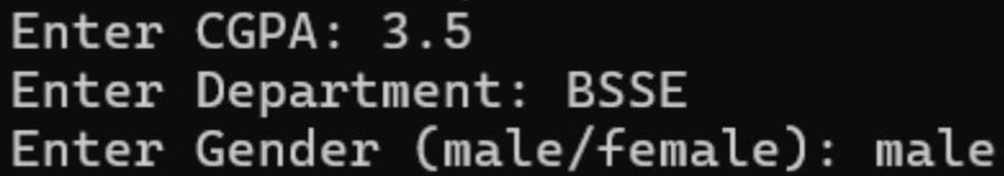
Data Structures & Algorithms Used
Binary Search Tree (BST)
Doubly Linked List (DLL)
Manages roll number-based search and sorting with efficient O(log n) average-case operations. Inorder traversal provides sorted output by roll number.
Used for CGPA-related search and sorting, allowing forward and backward traversal with easier insertion and deletion.
Custom Stack
Sorting & Search Algorithms
Implements an undo feature by storing previous states using a DLL-style structure for managing history.
Includes BST inorder traversal and bubble sort for sorting, binary search via BST, and linear search on DLL for CGPA.

Slide 3
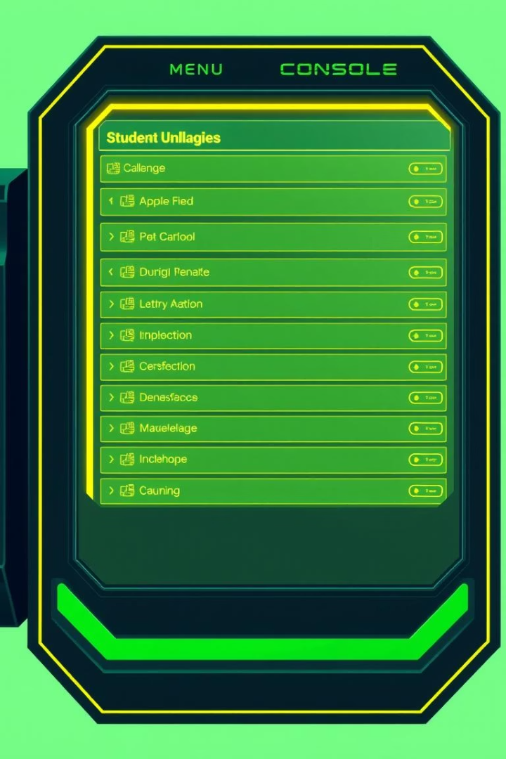




Implementation Overview
Main Menu Interface
Console-based menu with options to add, delete, update, search, sort, display, undo, clear file, and exit.
Add Student
Insertion into BST and DLL structures to maintain roll number and CGPA order.
Search & Update Features
Search by roll number using BST and by CGPA using DLL. Update and undo operations enhance usability.
Undo & Delete
Custom stack supports undoing last operations. Delete feature removes student records from data structures.

Slide 4
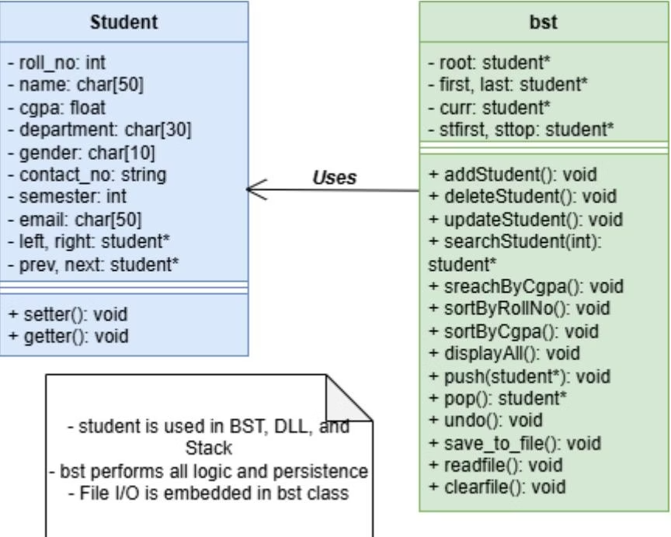
UML Class Diagram & Explanation
Student Structure
bst Class
Design Benefits
Contains student data fields and pointers for BST (left, right) and DLL (prev, next) to organize records.
Encapsulates core operations: add, update, delete, search, sort, undo, and file persistence for data management.
Modular design separates data representation from logic, making the system flexible, efficient, and maintainable.

Slide 5

Performance Analysis & Optimization
Feature
Approach
Time Complexity
Remarks
Add/Search/Delete
BST
O(log n) avg
Efficient for large datasets
Sort by Roll No
Inorder Traversal
O(n)
Linear for built BST
Sort by CGPA
Bubble Sort
O(n²)
Acceptable for small datasets
Search by CGPA
Linear Search
O(n)
Simpler logic, flexible traversal
Undo Feature
Custom Stack
O(1) push/pop
Efficient and modular

Slide 6




Member-wise Contributions
Faizan Ul Hadi
Sahal Bin Amin
Naqeeb Ur Rehman
Kashan Haider
Developed ADD and UPDATE modules for the system.
Implemented the DELETE module handling record removals.
Handled DISPLAY, FILE I/O, and UNDO modules enhancing usability.
Worked on SEARCH and SORT modules for efficient data retrieval.

Slide 7
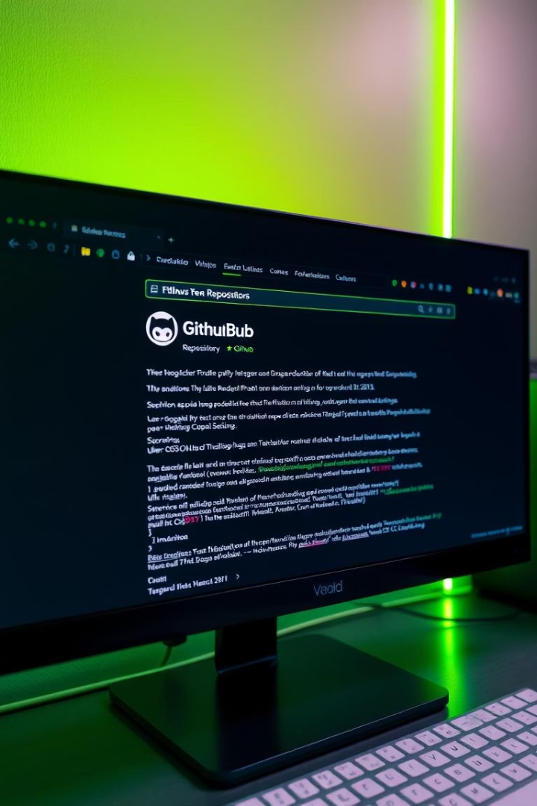
Project Links & Resources
GitHub Repository
https://github.com/Naqeeb-00/Student-Management-System
LinkedIn Post
https://www.linkedin.com/posts/naqeeb-ur-rehman-27b357351_cplusplus-datastructures-studentproject-activity-7333218073346240512-Cro3

Slide 8

Conclusion & Learnings
This project demonstrates practical use of key data structures like BST and DLL to manage complex student datasets efficiently. Features such as undo, file persistence, and sorting enhance robustness and usability.
It strengthened our understanding of system design, file I/O, and modular programming, providing a solid foundation for advanced management systems and real-world applications.

